Slide 1
Interrupting and preventing Discriminatory ACTS at Interscholastic Events: Follow up & Scenarios
OREGON SCHOOL ACTIVITIES ASSOCIATION

Slide 2
Complaint Form Data
71% of complaints received during
Football: 30%
Soccer: 20%
Basketball 21%
Nature of complaints:
Discriminatory Act/Discriminatory Harassment
Unsportsmanlike behaviors
Submitted against:
Student sections
Coaches
Athletes/Participants
Administrators/Athletic Directors
Spectators
Notes:
Review statics and discuss possible incidents that have been seen/reported in your organization.
A few other statistics that are not included on slide:
Almost all complaints filed regarding volleyball events were regarding student section behavior.
Discriminatory acts that were interrupted in the moment (by a coach, another athlete, an administrator, an official, or somebody else) may still be reported via the complaint form, but the follow through is typically easier as action has already taken place and typically follow up actions are already discussed between the schools involved.
In 2022-23, submitted complaints regarding on court or on field discriminatory acts decreased from previous years’ reports. This may be due to officials taking more action due to the training received as well as officials being asked to report the behaviors to administrators and coaches at the time of the reported or witnessed incident.

Slide 3
Common Reports
Use of racial slur during competition
Often times reported to coach or official
Spectator/Student section harassing athletes during game
Discriminatory language used
Spectator interactions before/after event occurs
Online
Student Section Theme night events

Slide 4
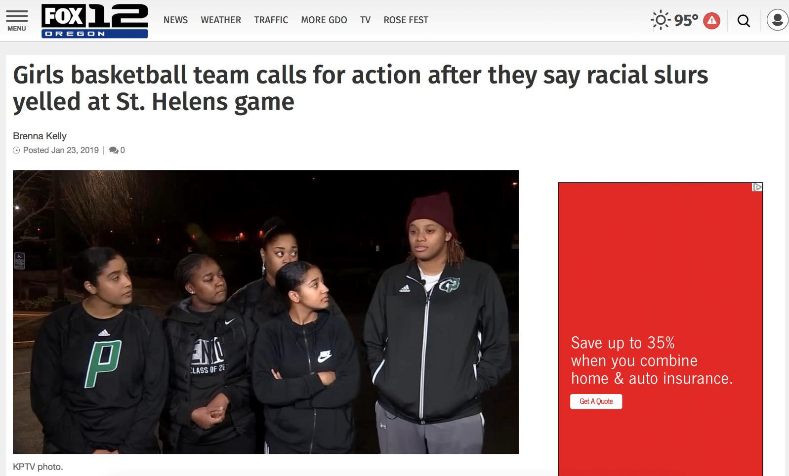
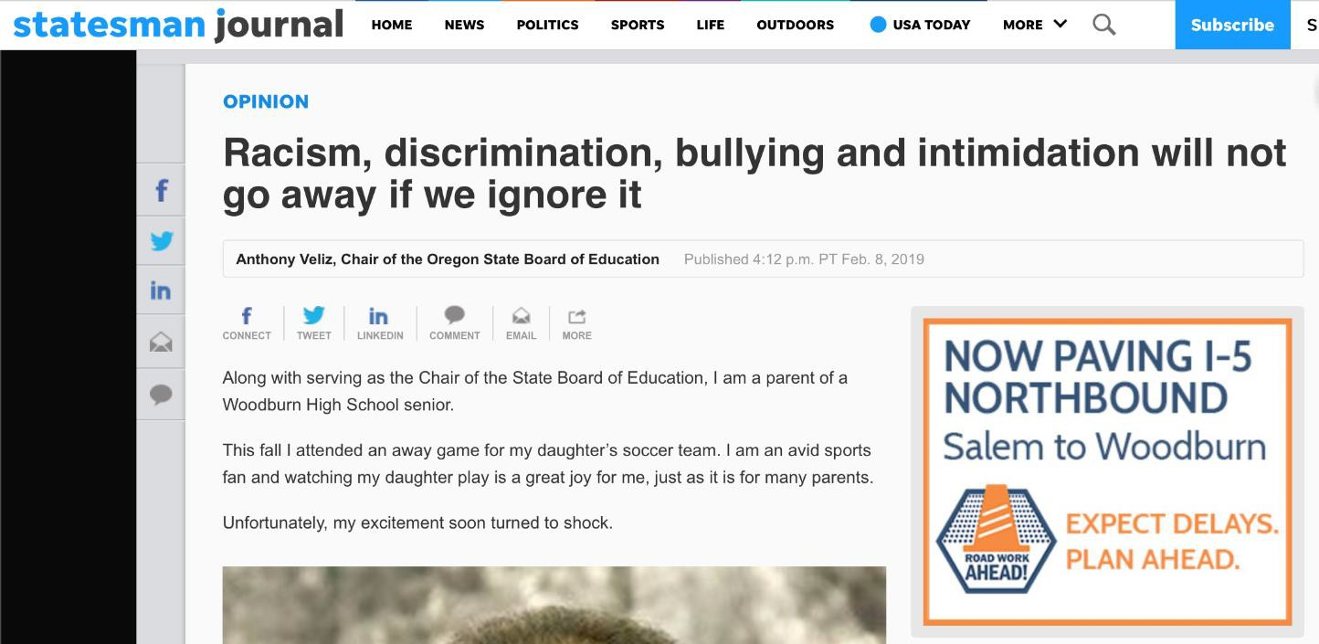
Oregon Incidents
www.osaa.org
Notes:
Examples of incidents that have occurred in the state of Oregon in recent years.
Links: https://katu.com/news/local/racial-slurs-at-high-school-basketball-game-prompts-change
https://www.oregonlive.com/opinion/2019/05/opinion-our-schools-ballfields-and-gyms-must-remain-free-of-hate-and-bigotry.html
https://theworldlink.com/sports/local/osaa-steps-up-rules-on-sportsmanship-at-contests/article_2d5d80b2-1b3c-5849-b68c-efbcec704c34.html

Slide 5
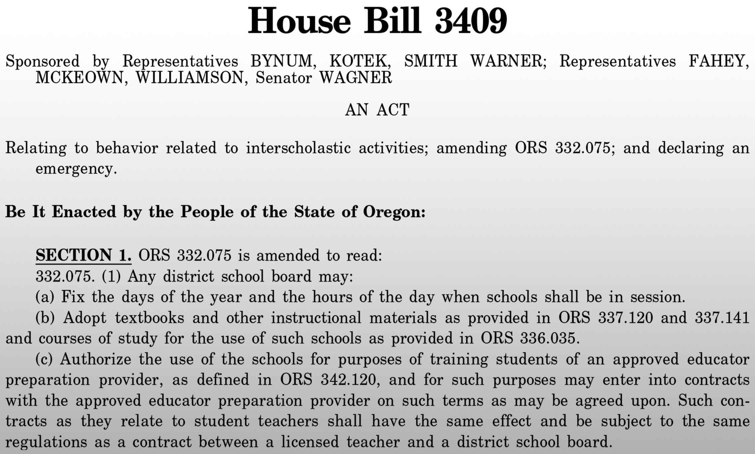
HB 3409, ANTI-DISCRIMINATION LAWS
Notes:
Purpose of House Bill 3409 is to hold voluntary associations such as the OSAA to work towards eradicating discriminatory acts and negative interactions taking place at interscholastic events.

Slide 6
FOCUS OF HOUSE BILL 3409
HB 3409:
(A) Implements policies that address the use of derogatory or inappropriate names, insults, verbal assaults, profanity or ridicule that occurs at an interscholastic activity, including by spectators of the interscholastic activity.
OSAA and member schools are focused on finding ways to better the experience of all participants and spectators at OSAA sanctioned events.
www.osaa.org

Slide 7
Complaint Response Process
OSAA sends notification email to each school’s superintendent, principal, athletic director (and district athletic director, if applicable) notifying all parties that the complaint is being reviewed and will need to be investigated by the schools.
Schools proceed with their investigative process with the parties involved from their school community.
As the investigation takes place, the school administrators communicate with the other school(s) involved as well as any of their school community members.
OSAA reviews responses and actions and determines whether further investigation is warranted (i.e. officials association, etc.) or if further actions or resources are needed to support the school’s follow through. This may include the services of a third-party investigator.
OSAA communicates with both schools as needed to finalize current and future steps. OSAA also communicates with complainant about the final follow through of the schools and/or OSAA.
Notes:
OSAA Complaint Process Steps
Link: https://www.osaa.org/docs/complaint/OSAA%20Complaint%20Process%20Response%20Guide.pdf

Slide 8
OSAA INTERRUPTING AND PREVENTING DISCRIMINATORY ACTS TRAINING
Prevention Strategies:
OSAA Rule 3 and Non-Discrimination Policy Overview
S.T.A.R. Initiative Expectations and Strategies
Response During an Interscholastic Event:
Immediate Event Incident Response
When Seen/Heard By Officials
When Reported To Officials
When Heard/Seen or Reported to Event Management
www.osaa.org
Notes:
Training Link: https://www.osaa.org/training-courses/discriminatory-acts/index.html

Slide 9


S.T.A.R. INITIATIVE
S.T.A.R. Mission Statement:
To create a safe, welcoming and validating environment in Oregon schools by specifically disrupting racism and combating discrimination, so EVERY student can thrive as they are.
www.osaa.org
Notes:
The S.T.A.R. initiative is focused on helping schools create a safe, welcoming, and validating environment by specifically disrupting racism and combating discrimination so every student can thrive. Each Oregon school has the opportunity to opt in as an official S.T.A.R. school. The OSAA, affiliated organizations and its membership want the program to grow, evolve and develop over time, and the program will incentivize schools and communities to do more through a tiered structure that allows schools the flexibility to introduce S.T.A.R. into their communities and a framework where communities can set goals for the future.
Link to S.T.A.R. Resources and S.T.A.R. Video: https://www.osaa.org/equity/star-resources

Slide 10
S.T.A.R. SCHOOL PROGRAM
Event Management
Signage
Pre-event communication
Monitor student sections
Interrupt acts of discriminatory harassment
Public address
Modeling good sportsmanship
Requiring it of participants and fans
Incident response protocol
www.osaa.org
Notes:
As part of the S.T.A.R. guidelines, schools are encouraged to post signage to help visiting participants and spectators know where facilities are and how to navigate an event; read a required S.T.A.R. public address at each OSAA-sanctioned event; and conduct a preseason meeting with student-athletes, coaches and parents to review the S.T.A.R. sportsmanship standards.

Slide 11
Role of the Game Administration/Event Managers
When discriminatory harassing behavior is reported to an event staff or administrator by a student or coach:
▪ Alert officials. Have officials, stop the game, immediately bring both coaches together to discuss what was reported. Explain to both coaches what behaviors were reported and that any such behavior will not be allowed to continue, and consequences will occur if reported again, including potential postponement of the game.
▪ Return coaches to their students to explain what was reported and the consequences that will be applied if the behaviors continue.
▪ Game administrator shall remain present and vigilant regarding other concerns that come up during the event.
Notes:
Review the expected steps if an incident occurs for each role.

Slide 12
Role of the Official
When discriminatory harassing behavior is heard or seen by an official:
▪ Apply NFHS rule as it should be enforced resulting in the appropriate penalty, which may include ejection from the contest. (below)
▪ Speak with both coaches immediately regarding the incident that occurred and ensure that coaches address their teams on expected behaviors for the remainder of the competition.
▪ Officials immediately alert event management of what has occurred so event management can follow through with the school(s) involved.

Slide 13
Role of the Official
When discriminatory harassing behavior is reported to an official by a student or coach:
▪ Stop the game, immediately bring both coaches together to discuss what was reported. Explain to both coaches what behaviors were reported and that any such behavior will not be allowed to continue, and consequences will occur if reported again, including potential postponement of the game.
▪ Return coaches to their students to explain what was reported and the consequences that will be applied if the behaviors continue.
▪ Officials immediately alert event management of what has been reported so event management can follow through with the school(s) involved.

Slide 14
Scenario 1
My team was waiting at the pool for the opposing team to enter. The team emerged from the locker room with kickboards. The athletes all were banging clipboards and were extremely loud. The athletes surrounded the pool and made mocking native American chant type sounds while banging the kickboards on their hands to make it sounds like a drum in a drum circle. My team was shocked and surprised by this racist culturally appropriative behavior. This behavior endured for three minutes.
Notes:
Discussion Points: How would your school/organization respond in the moment?
Interrupt, address students, follow-up with sanction
Non-discrimination policy review
Look to repair/restore
What would be your continued follow up with the opposing school(s)?
Work to regain trust with other school - shake hands, share meal, conversation with captains…
Work hand in hand with the other school, OSAA, interested parties
Prevention - intervention - postvention
Communicating with parents, communities, press, students, schools
Education to restore, improve relationships

Slide 15
Scenario 2
During a highly emotional game for both teams, an athlete on the field reported the use of the N-word against him to the coaches. Two other players followed and said they had heard a student on the opposing team call our athlete the N-Word. The coaches did not feel comfortable reporting it to officials at that time as it was the last possession.
Our administration interviewed our student who was called the N-word and the other two players that heard the incident. All of them reported directly hearing the opposing player say the N-word. After the game while shaking hands, the head coach from the opposing team apologized to both my athletes and said he would take care of it.
Notes:
Discussion Points:
What preparation has your school/district done to prepare to respond in an occurrence like this?
Equity lessons for all students - needs more training for facilitators
Training for coaches
Every Student Belongs - policy review
Implicit bias training with coaches - STAR
How would your school/organizations respond in the moment?
Non-discrimination policy review
Interrupt, address students, follow-up with sanction
Look to repair/restore
What would be your continued follow up with the opposing school(s)?
Work to regain trust with other school - shake hands, share meal, conversation with captains…
Work hand in hand with the other school, OSAA, interested parties
Prevention - intervention - postvention
Due process is important
Communicating with parents, communities, press, students, schools
Education to restore, improve relationships

Slide 16
Scenario #3
Throughout the game student body / spectators of the host school made monkey noises and other animal sounds when any of the opposing school’s students of color went back to serve. At no point during the game management, officials or coaches intervene.
Students from the visiting schools left the facility crying and clearly upset. The coach from the opposing team also appeared to be upset when leaving the facility.
Notes:
Discussion Points:
What preparation has your school/district done to prepare to respond in an occurrence like this?
Equity lessons for all students - needs more training for facilitators
Training for coaches
Every Student Belongs - policy review
Implicit bias training with coaches - STAR
How would your school/organizations respond in the moment?
Non-discrimination policy review
Interrupt, address students, follow-up with sanction
Look to repair/restore
What would be your continued follow up with the opposing school(s)?
Work to regain trust with other school - shake hands, share meal, conversation with captains…
Work hand in hand with the other school, OSAA, interested parties
Prevention - intervention - postvention
Due process is important
Communicating with parents, communities, press, students, schools
Education to restore, improve relationships

Slide 17
Best Practices for Interscholastic Events
» Purposeful Planning for OSAA Events Memo Contains OSAA information as schools prepare for league/state playoffs, it is important that host schools remember that there should be intentional efforts made to communicate with visiting schools in advance of a contest in order to provide a welcoming environment for visiting participants and spectators.
Code of Conduct
» Oregon Department of Education: Guidance on Discriminatory Harassment and Bullying in Student Activities and Athletics
» OASC examples for Spirit Dress Up Days/Nights » OASC resource regarding ways schools and administrators can help promote the value of student activities
» OSAA Event Management Suggestions

Slide 18
QUESTIONS
Contact Information:
OSAA Executive Director, Peter Weber: peterw@osaa.org
OSAA Asst. Executive Director, Monica Maxwell: monicam@osaa.org

